Slide 1
Comparative Genomics By Phylogenetic Tree
BY:
Aly Farag
Rahma Abbas
Menna Shakran
Under supervision of:
Dr.Eman Badr
TA.Reem Ali

Slide 2
TABLE OF CONTENTS
01
02
03
04
Introduction
Our Data
Proposed Approaches
Discussion
Conclusion

Slide 3
01
Introduction

Slide 4
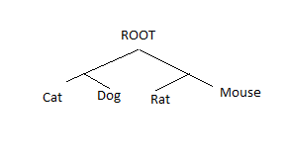
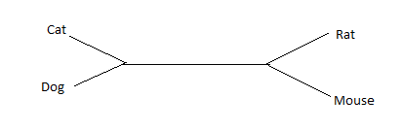
What is the Phylogenetic tree?
It is described as a diagrammatic portrayal of the relationships between living things in terms of evolution.
Rooted and Unrooted
It is used to determine the most recent common ancestor and how closely related different species are to one another.
In a preclinical trials, Phylogenetic tree is used to determine the most close gene to the homosapien.

Slide 5
How to Construct a Phylogenetic Tree
Choosing a Molecular marker
(A Sequence)
Performing MSA
Determining a Tree-Building Method
Checking Tree Reliability
Notes:
In fact, the ML method, in common with the Neighbor Joining, Parsimony, and Bayesian Inference methods, is incapable of determining the root of a tree; all those methods estimate unrooted trees.

Slide 6
1- Choosing a Molecular Marker
2- Performing Multiple Sequence Alignment
Before we begin Tree-Construction, we need to choose the Object of comparison which in our case is going to be DNA sequence (A,T,C,G).
MUSCLE Tool
Needle-Wunsch Alignment

Slide 7
3- Choosing a Building Method:
Alignment-based methods as Maximum parsimony and Maximum Likelihood
Non-Alignment based methods (K-mer)

Slide 8

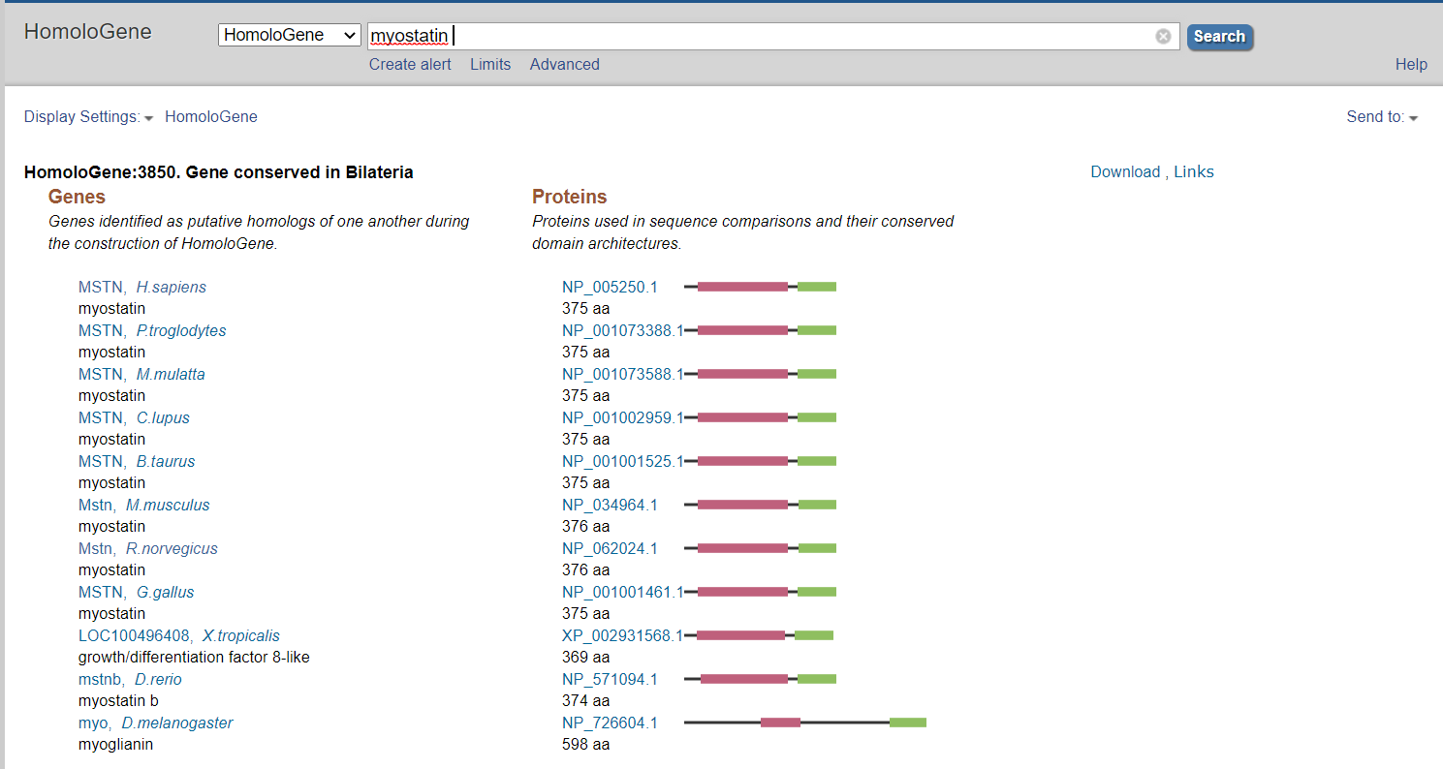
Get Data
We will work with some genes in different species.
We can download it from NCBI as a FASTA file for different species.
tlr3-tlr8-nlrc3-calr-ikbke→Five immune system genes.
COX 1, COX 2, COX3
Coronavirus with different species.
rpoB gene for 6 different staphylococcus aureus.

Slide 9
Checking Tree Liability
Bootstrap analytical Technique: repeatedly sampling trees through slight perturbed datasets.
Jacknife analytical Technique: ½ of the sites in datasets are deleted creating half as large datasets.

Slide 10

Maximum Likelihood
Character based Method 1 !!

Slide 11
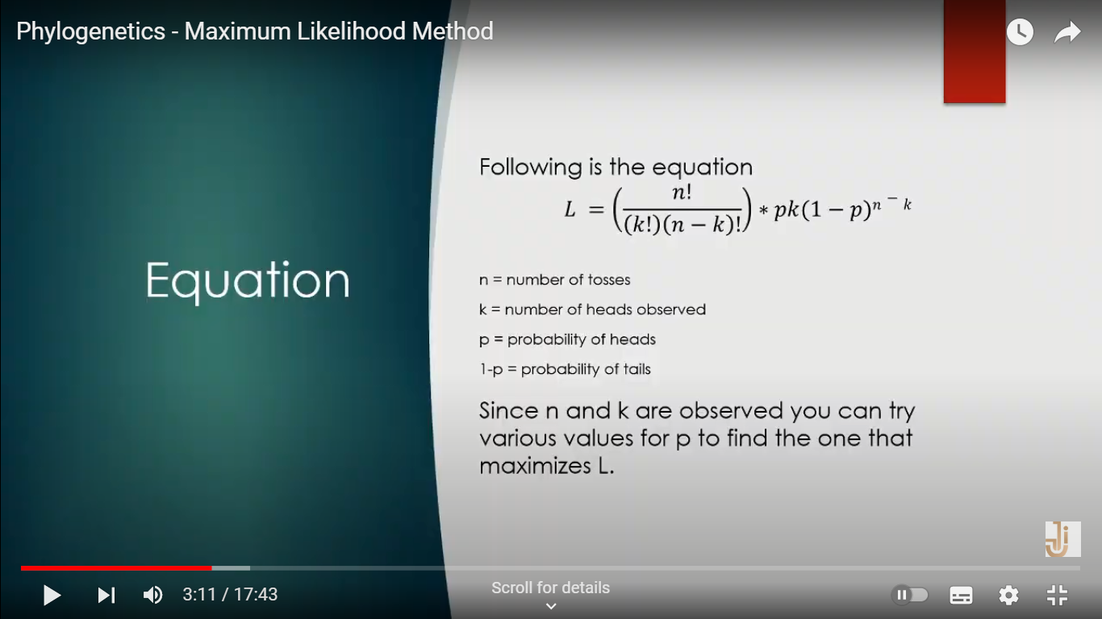
Maximum Likelihood
Likelihood Equation
Maximum-Likelihood is a method based on probabilistic models, it calculates degree of likelihood and then chooses the best tree
which normally has the highest probability
n = number of sequences used
k = number of recorded sites of nucleotide observations.
p = probability of similarity

Slide 12
The Logistic Method
In Order to draw out the maximum Likelihood tree, Three Arguments are taken into consideration:
Substitution model
Testing all possible tree combinations and choosing the best.
A matrix is computed for all tree combinations using Needle-Wunsch
The best tree is determined by adding the total probability expressed log likelihood for each column, in a mutation matrix.
Number of free parameters
All are done through using PhyML tool.

Slide 13
Multiple_Sequence_Alignment
For the Multiple Sequence alignment, MUSCLE tool was used.
MUSCLE tool, is based on the Muscle Algorithm which proceeds in three stages:
Draft Progressive:
Calculating k-mer distance between every pair of input sequences to create a distance matrix. Then the matrix is used to compute binary tree using UPGMA clusters
Improved Progressive:
Calculating the Kimura distance for each pair of input sequences using the multiple sequence alignment obtained in draft progressive stage, and creates a second distance matrix
Refinement:
it is optimized by only computing alignments in subtrees whose branching orders have changed from the first binary tree, resulting in a more accurate alignment
However, it does not compare Whole genomes.

Slide 14
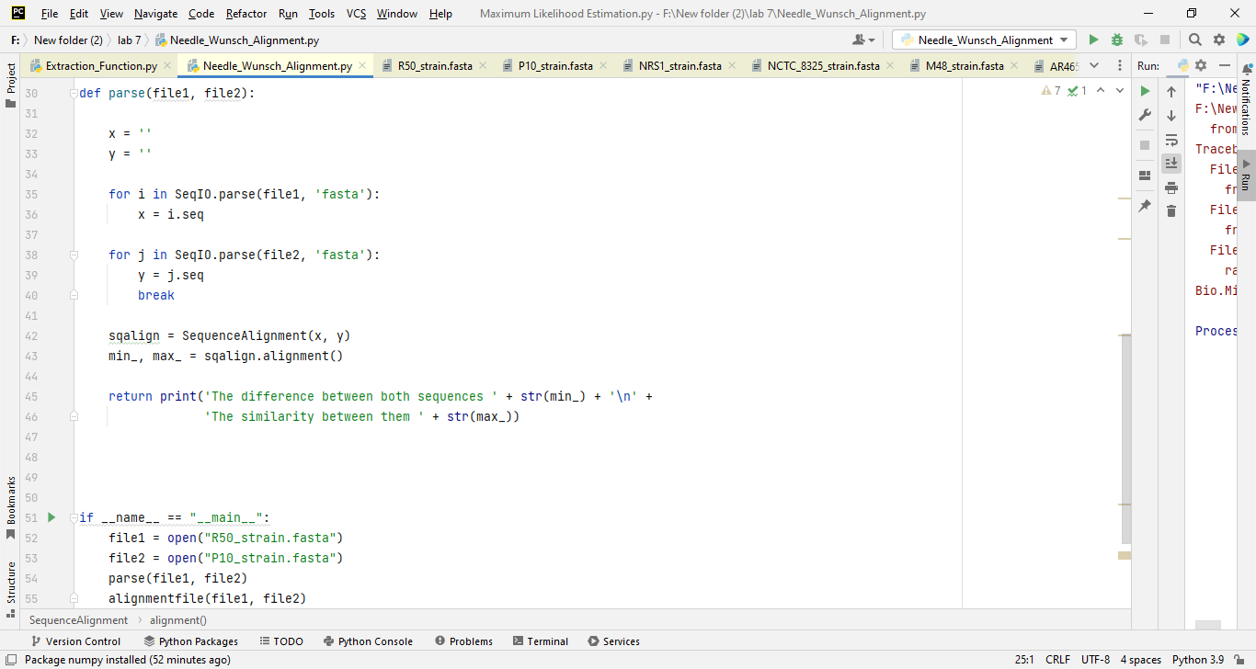
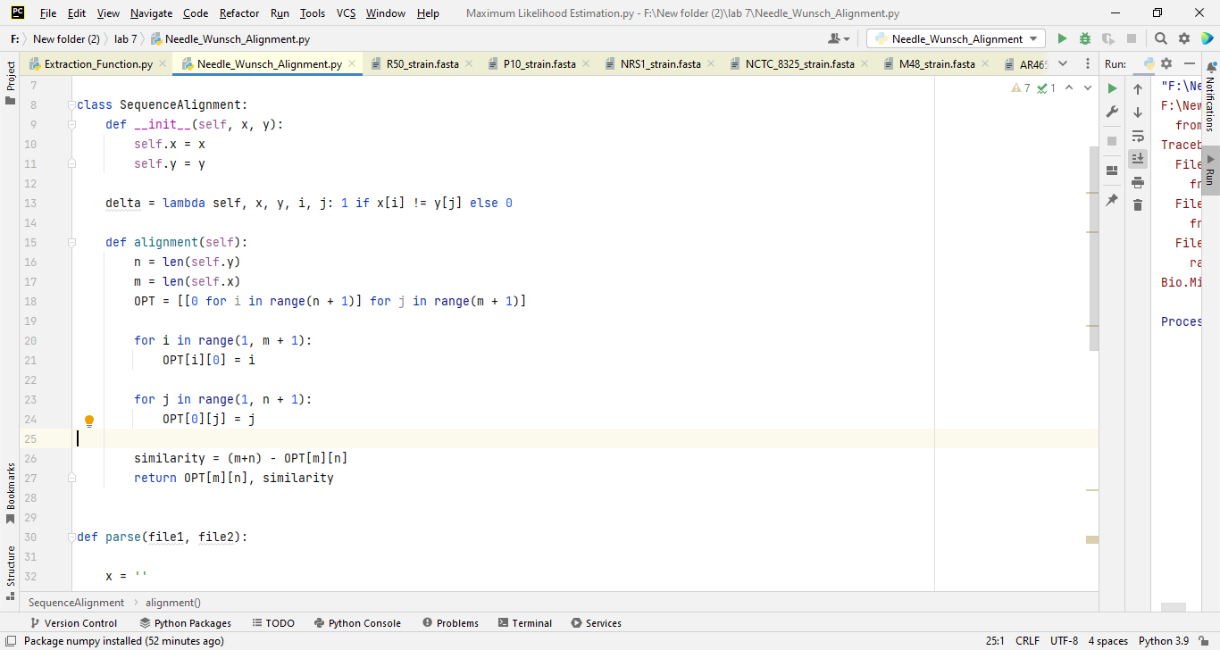
Needle-Wunsch Alignment

Slide 15
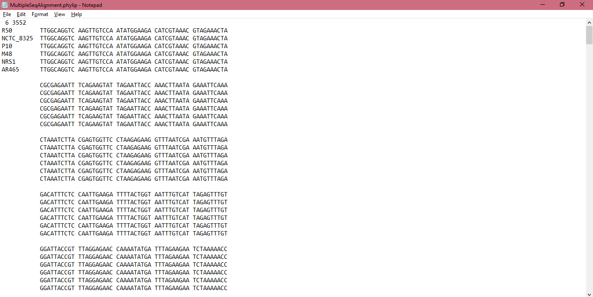
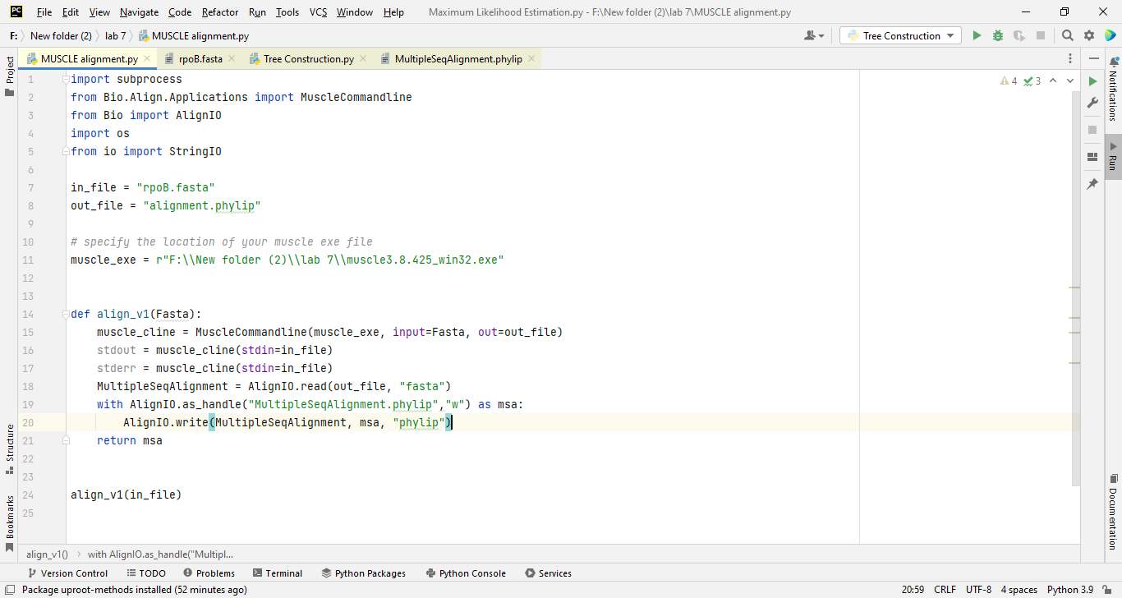
Multiple Sequence Alignment

Slide 16
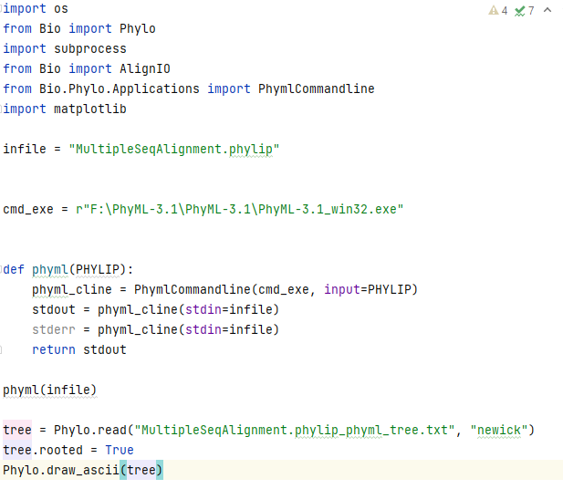
Drawing Tree

Slide 17
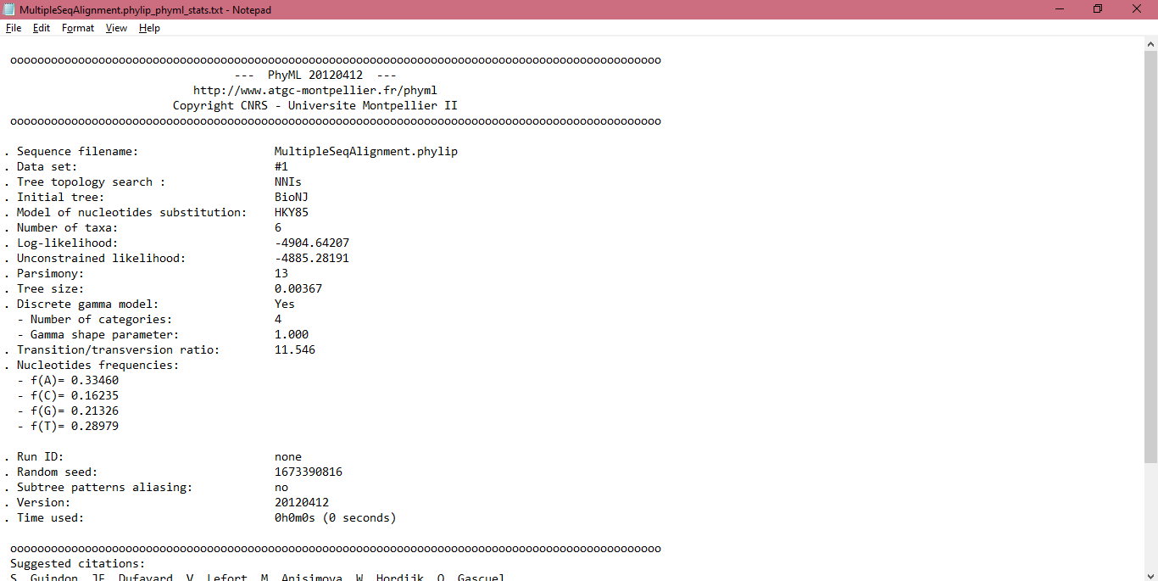
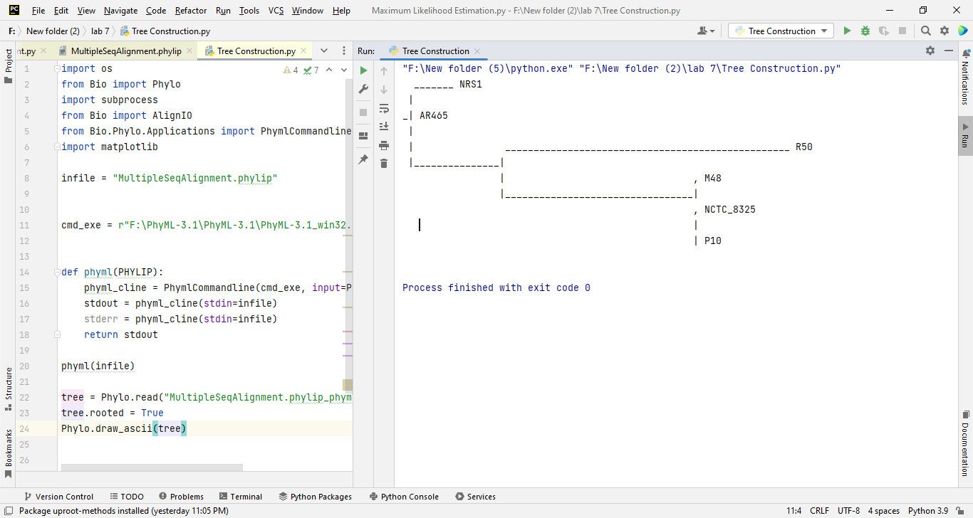
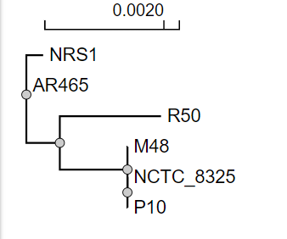
Output Files

Slide 18

The Difference Between
Maximum
Parsimony
Maximum Likelihood
Takes Less time to compute trees as it only takes into consideration
“informative sites”.
Takes more time to compute trees as it considers all possible tree topologies.

Slide 19
Maximum Parsimony
Character based Method 2 !!

Slide 20
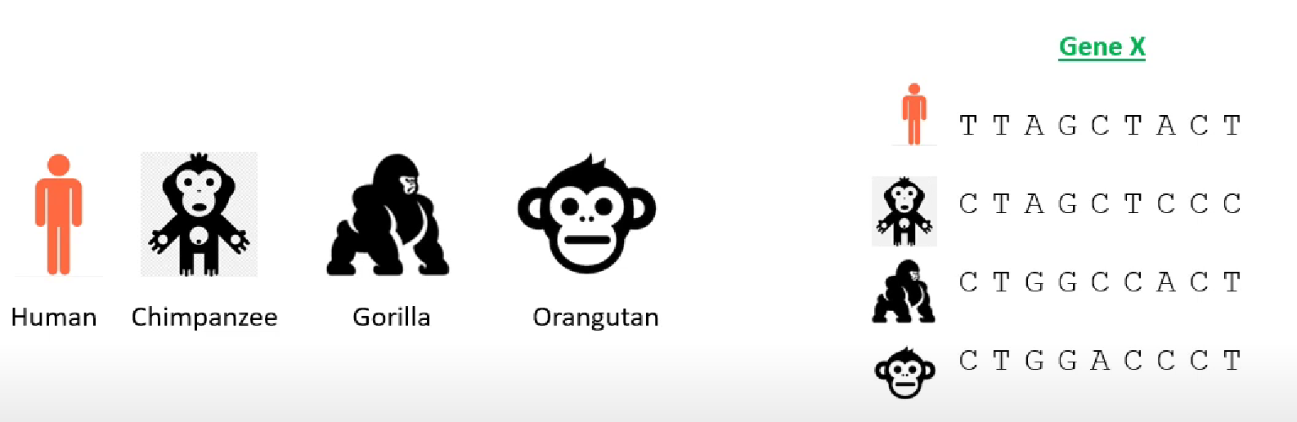
Maximum Parsimony is a character-based approach that infers a phylogenetic tree by minimizing the total number of evolutionary steps required to explain a given set of data assigned on the leaves

Slide 21
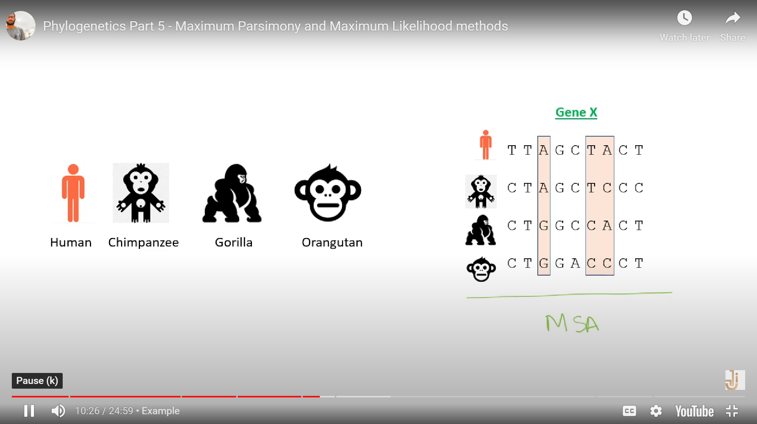
Informative sites:
Sites that have at least two different kinds of characters, each occurring at least twice.

Slide 22
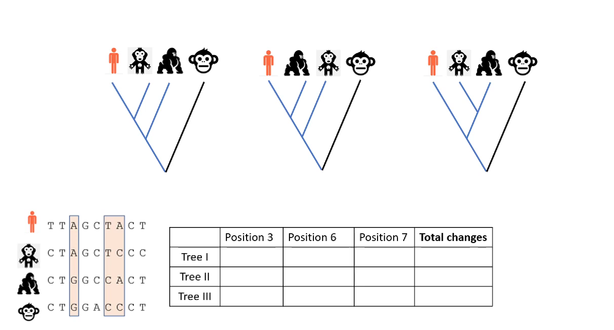
1
1
2
4
2
2
1
5
2
2
1
5

Slide 23
In Progress(Workflow)
Informative Sites
Probabilities of the trees
Number of mutations in each tree

Slide 24
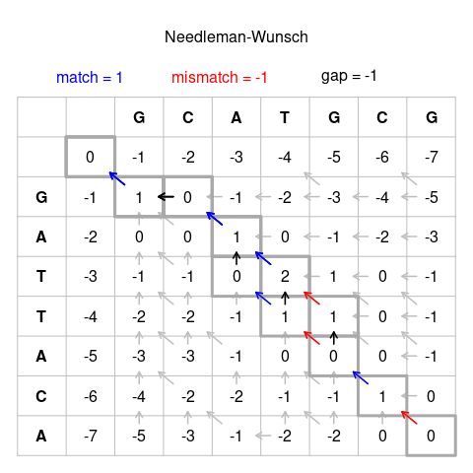
Needle-wunsch Alignment

Slide 25
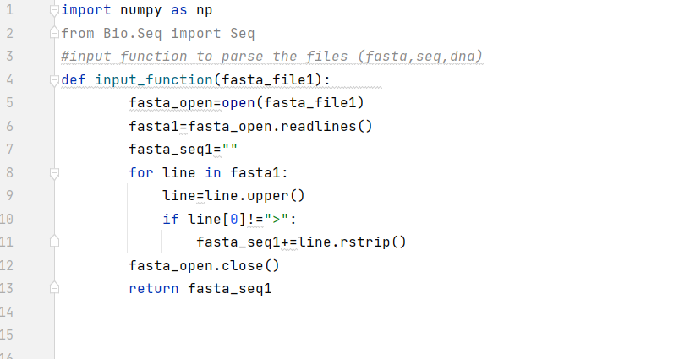
Alignment

Slide 26
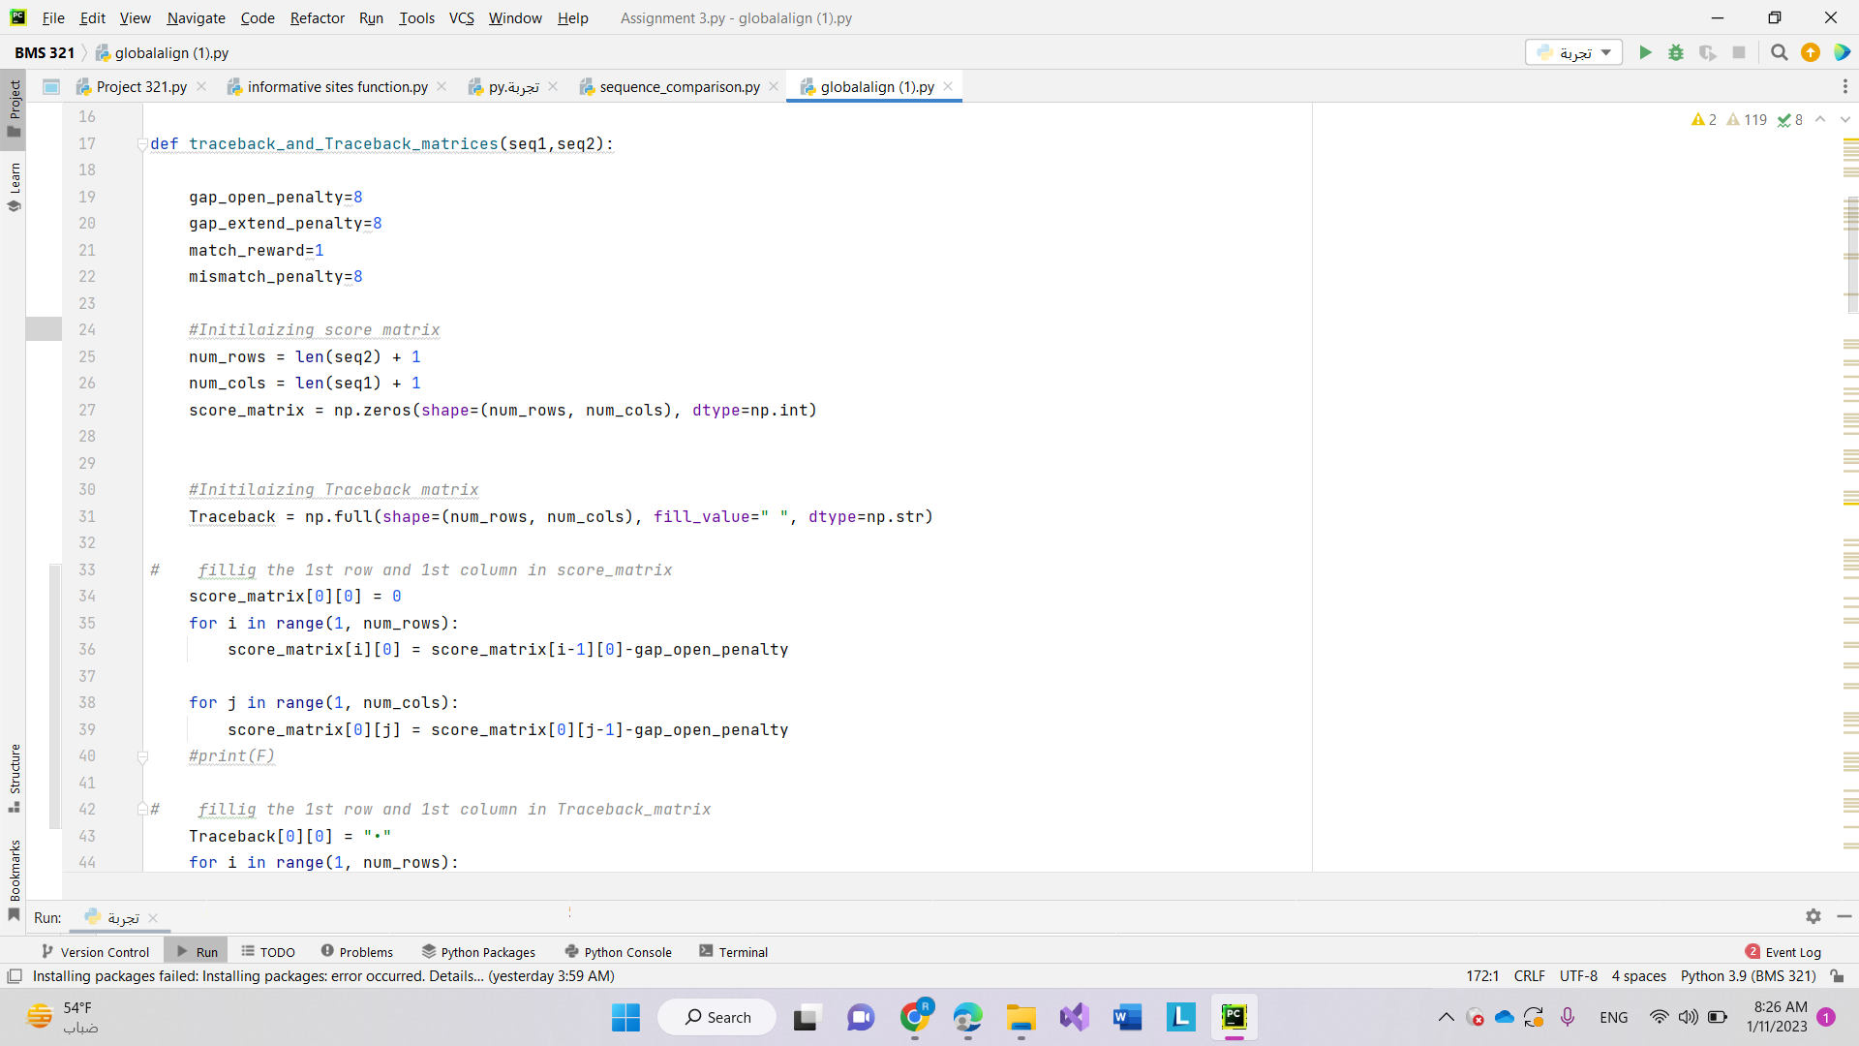

Slide 27
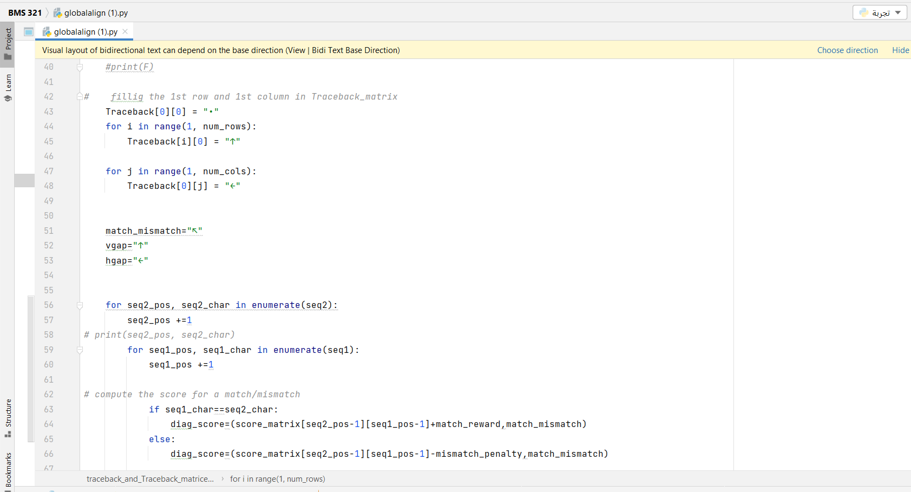

Slide 28
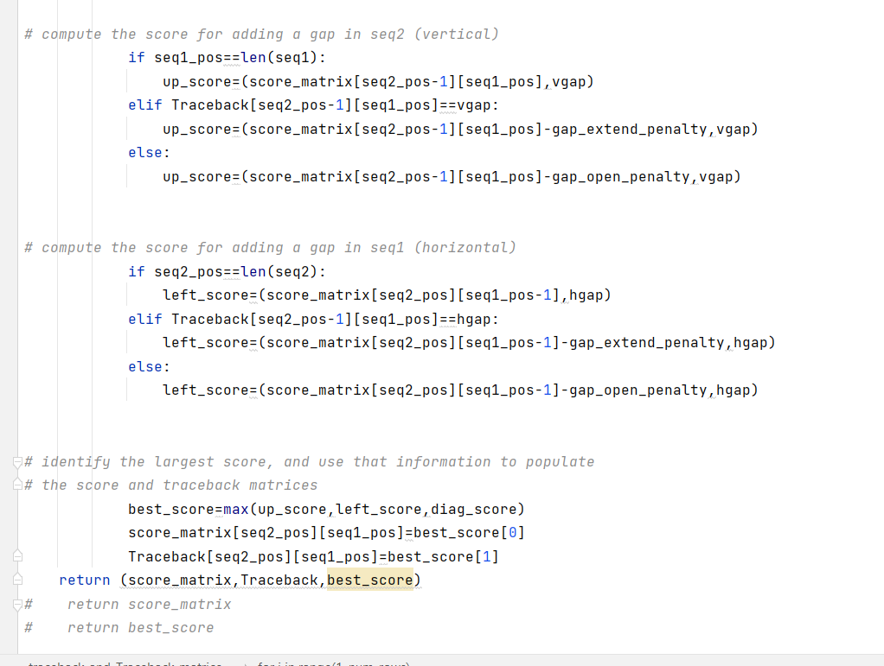

Slide 29
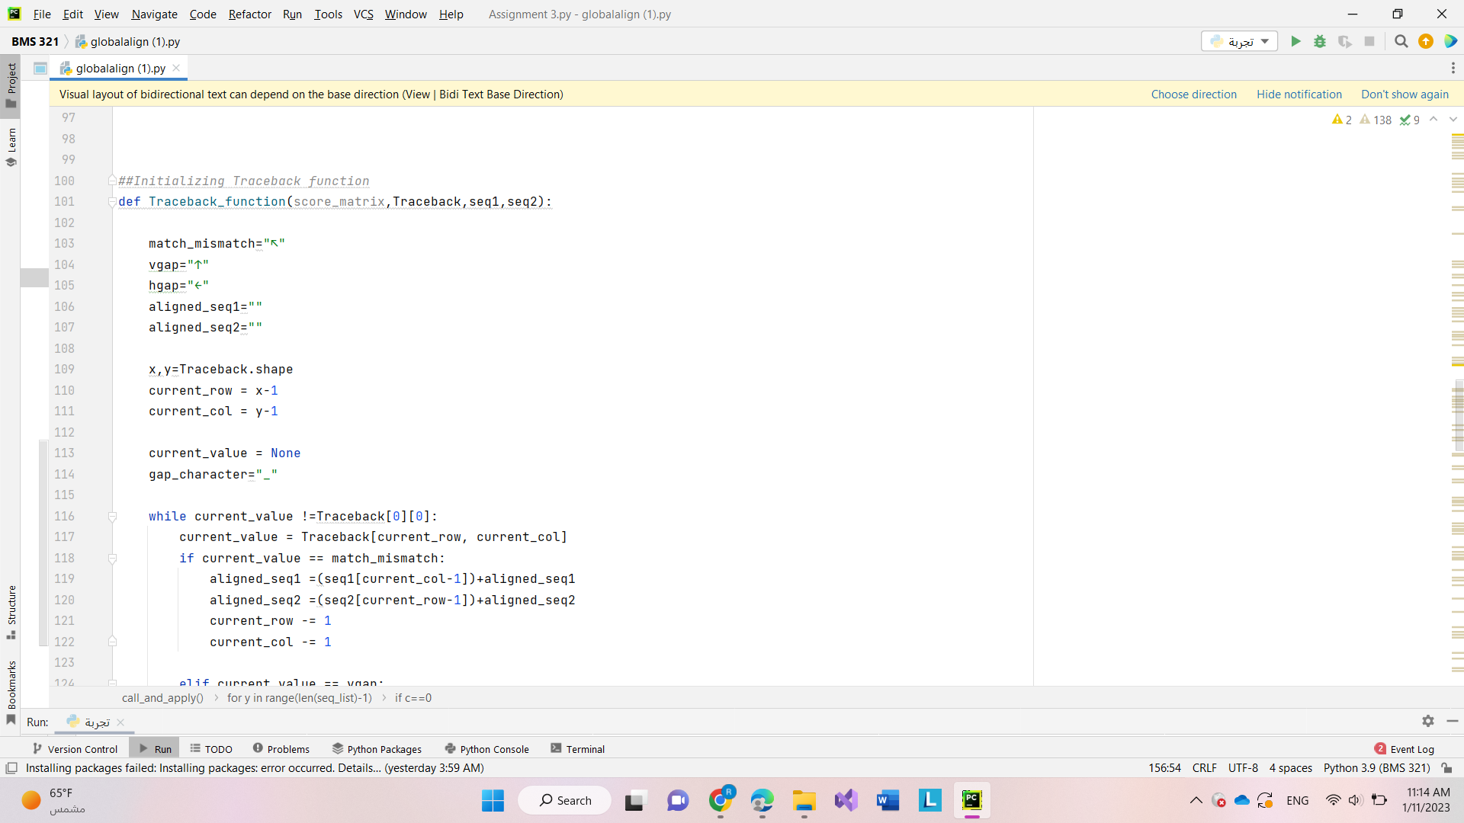
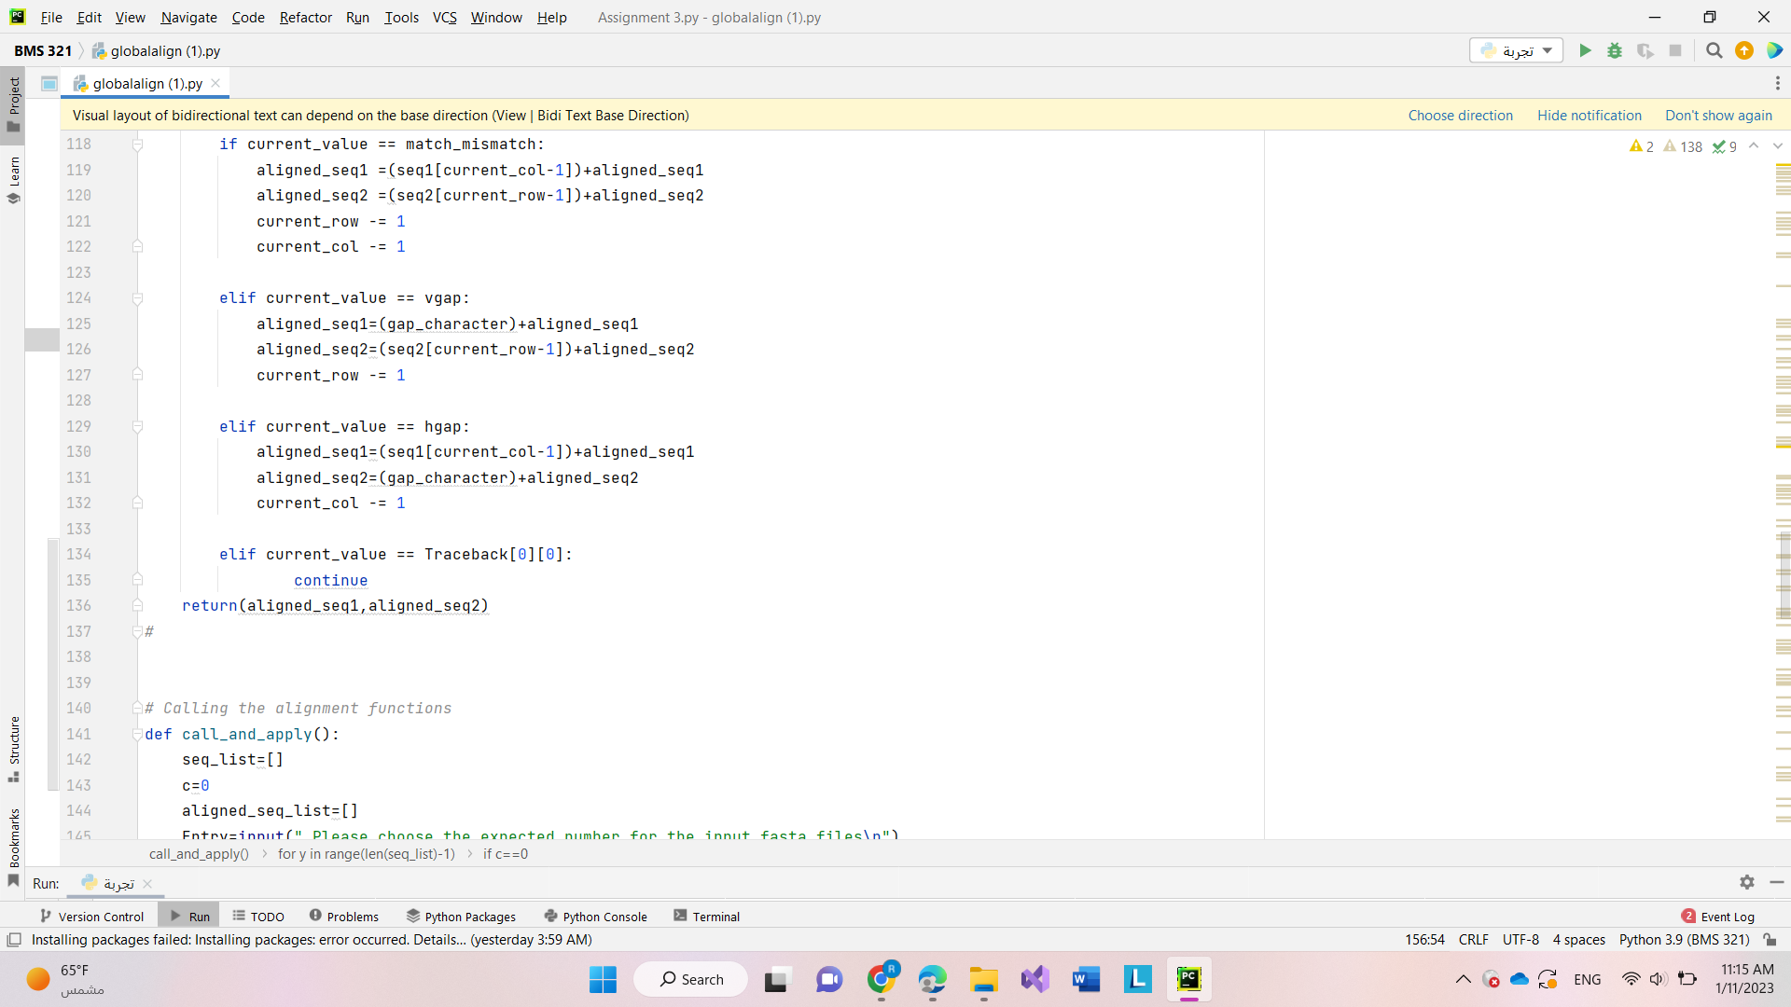

Slide 30
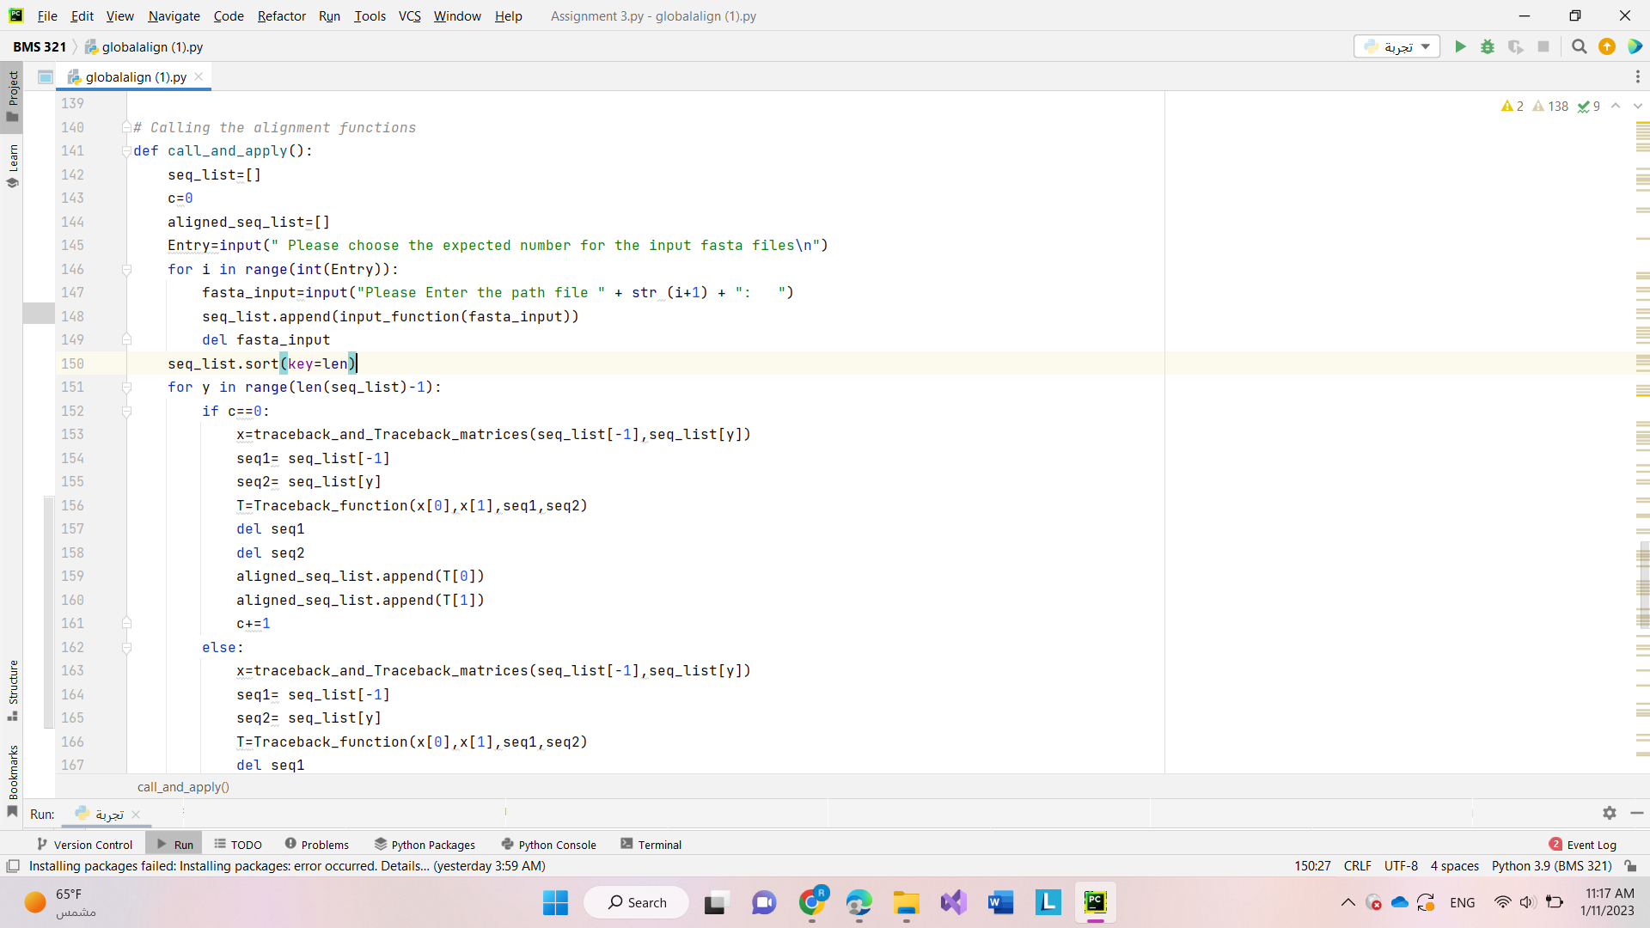

Slide 31
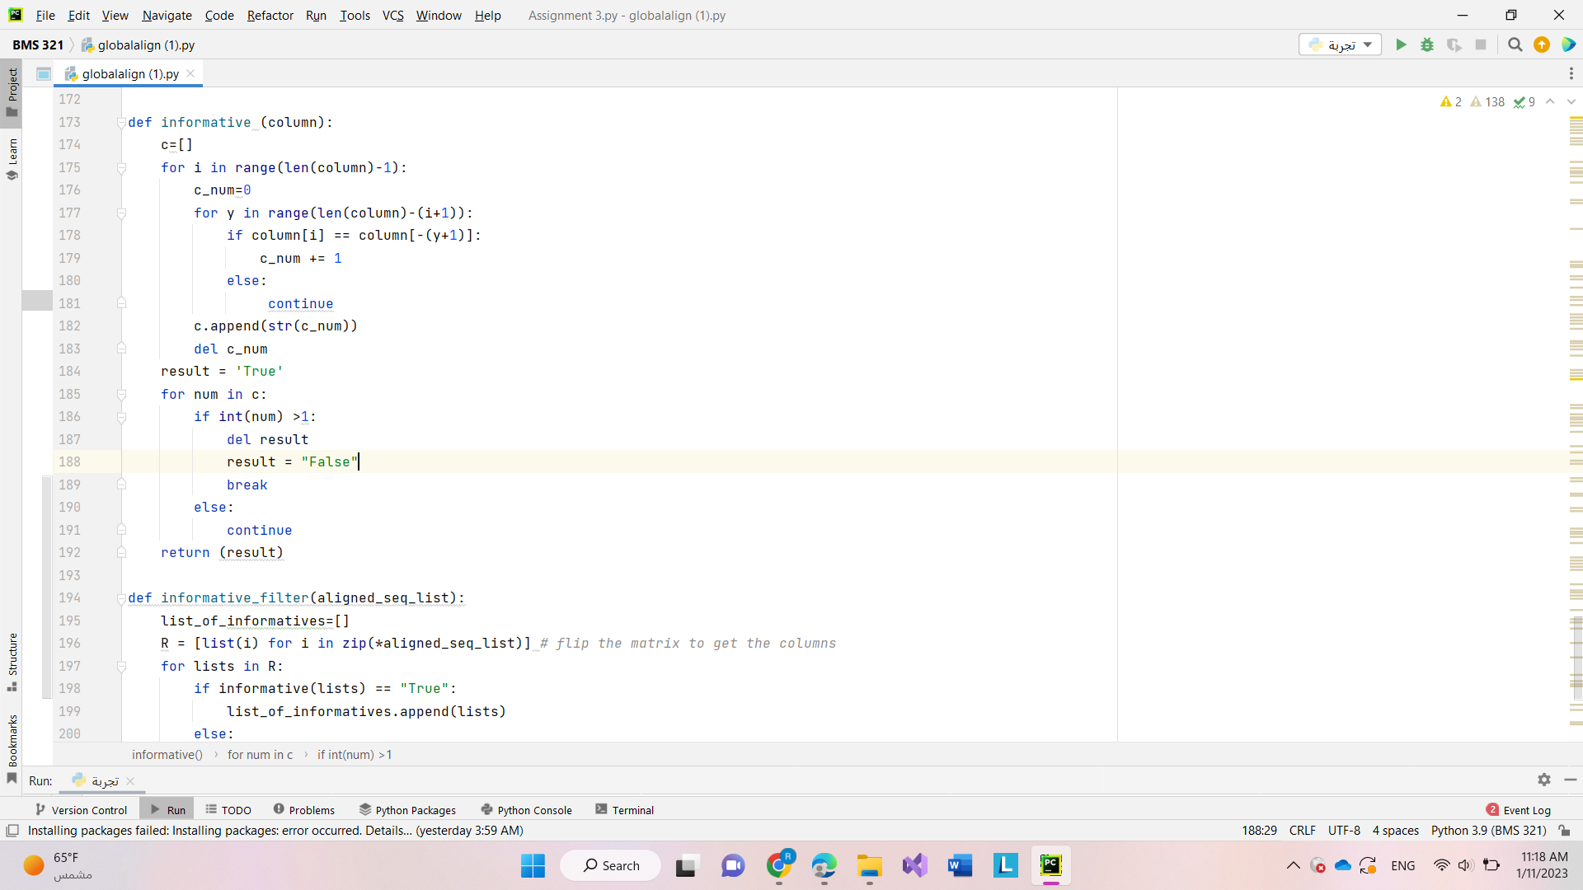
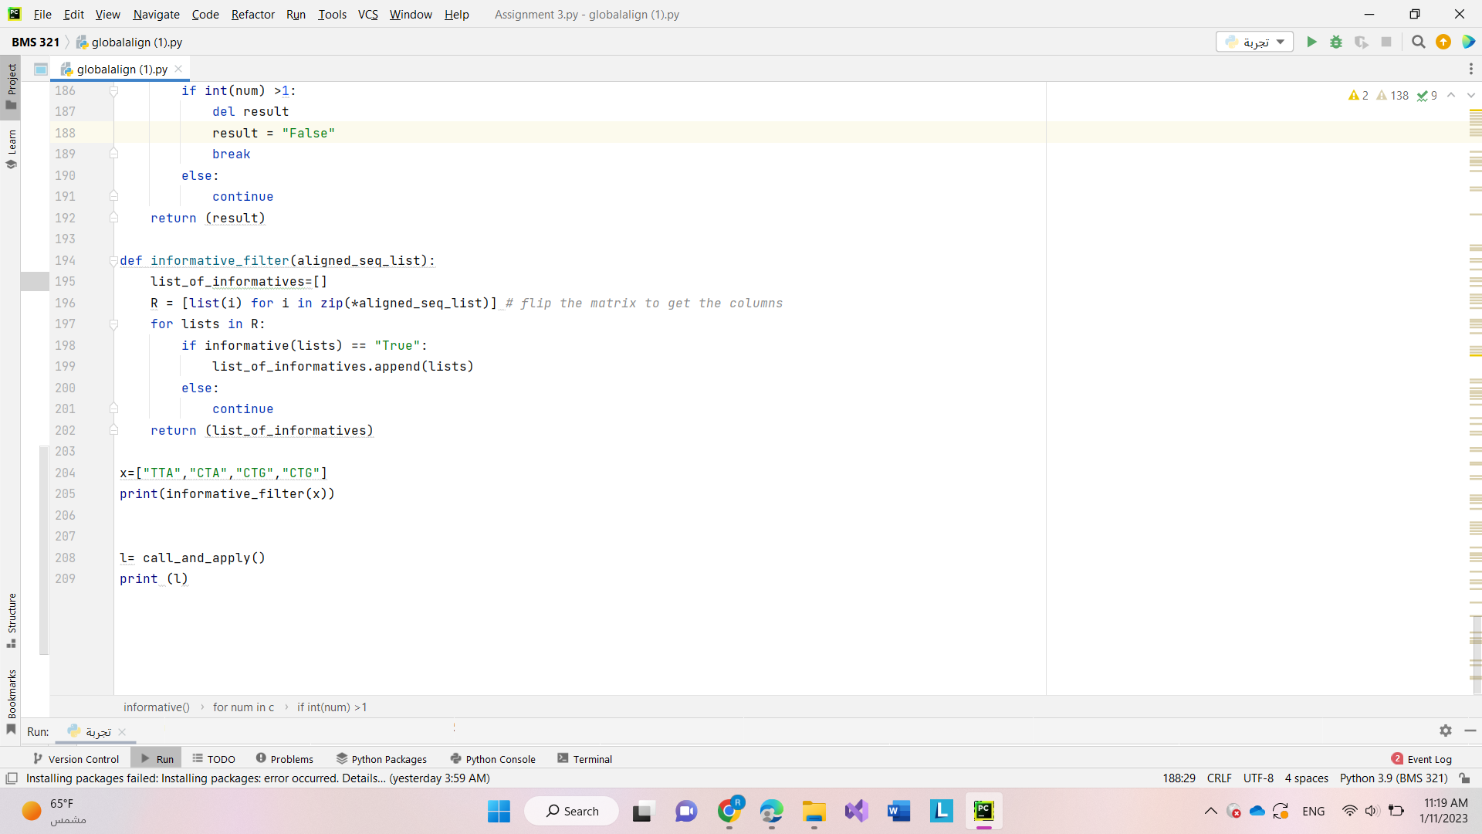

Slide 32
Alignment-Free
Building Method 3 !!!

Slide 33
The primary advantage of alignment-free methods for creating phylogenetic trees
They do not require an alignment of the input sequences, which can be computationally intensive and prone to errors.
Alignment-free methods instead rely on comparing the overall similarity or dissimilarity of the sequences using various mathematical or statistical methods, such as comparing the frequency of k-mers, or small sub-sequences, in the sequences.
This can make alignment-free methods faster and more robust to errors than alignment-based methods, especially when the sequences are highly divergent or contain many insertions and deletions.

Slide 34
METHODOLOGY
Obtain a file containing gene sequences for multiple species from the user.
Parse the file to create a dictionary, with species names as keys and their corresponding gene sequences as values.
Develop a function that calculates the pairwise distance between species' sequences based on k-mers.
Create a distance matrix that encompasses the distances between all the species' sequences.
Using the distance matrix, generate a Newick string representation of the phylogenetic tree.
Plot the generated Newick string to visually depict the phylogenetic tree.

Slide 35
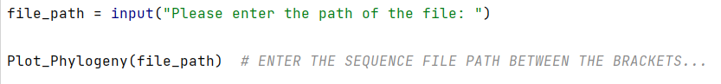
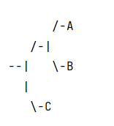
MAIN SCRIPT AND EXPECTED OUTPUT
Main Script
Expected Output

Slide 36
MAIN ALGORITHM
The idea that comparing the occurrences of short, overlapping substrings (k-mers) of a given length (k) within the sequences can provide information about their evolutionary relationships.
The algorithm typically proceeds as follows:
First, the sequences to be analyzed are divided into k-mers of a specified length (k). For example, if k = 3, then the sequence "ATGGCAT" would be divided into the 3-mers "ATG", "TGG", "GGC", "GCA" and "CAT".
Next, the occurrences of each k-mer are counted across all the sequences, resulting in a k-mer frequency table.
Using the k-mer frequency table, a pairwise distance can be calculated to measure the dissimilarity between all pairs of sequences.

Slide 37
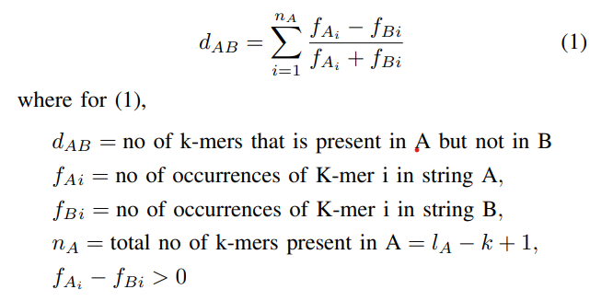

EQUATIONS

Slide 38
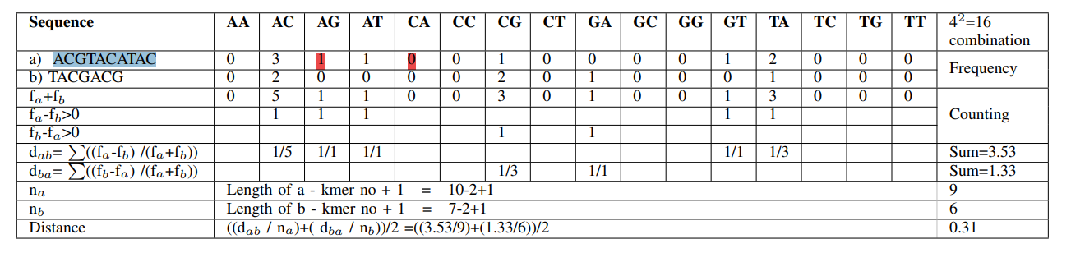
Main Algorithm

Slide 39
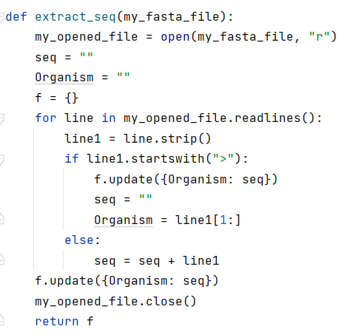
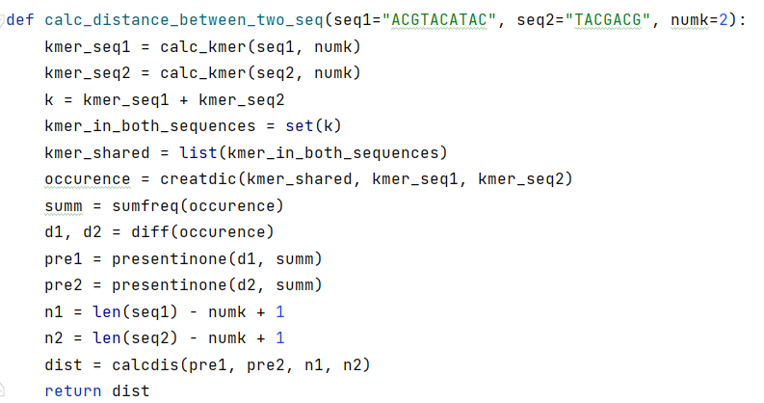
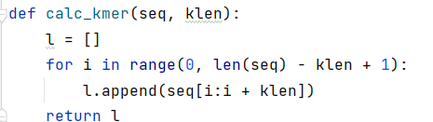
Some Important Functions

Slide 40
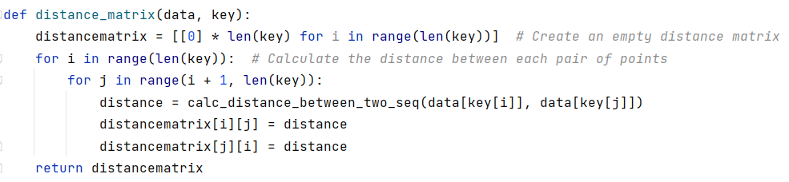
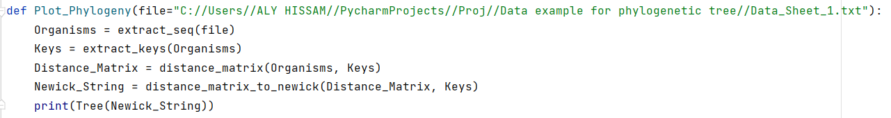
Some Important Functions
Newick Example: ((A:0.1, B:0.2):0.3, C:0.4);

Slide 41
Distance Matrix Into Newick String
I tried to use the Unweighted Pair Group Method with Arithmetic Mean (UPGMA) algorithm to construct the phylogenetic tree from a distance matrix.
Start with a distance matrix and a list of leaves representing the individual species.
Find the two most similar sequences or clusters (i, j) by finding the smallest value in the distance matrix.
Merge the two most similar sequences or clusters into a new cluster, and calculate the average distance between each member of the new cluster and the members of the other clusters.
Update the distance matrix by replacing the row and column of the two most similar sequences or clusters with the new cluster's distance information.
Repeat steps the past three steps until there is only one cluster left, which corresponds to the root of the tree.
At each step of the algorithm, an internal node is added to the tree and branches are assigned the appropriate distances.
Finally, the tree is represented as a nested set of parentheses, similar to a Newick string.

Slide 42
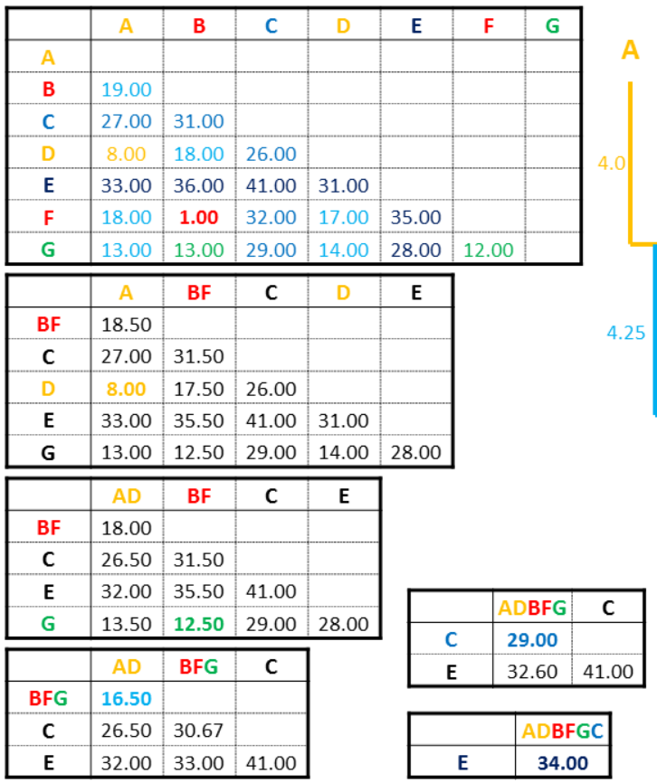
UPGMA Algorithm

Slide 43
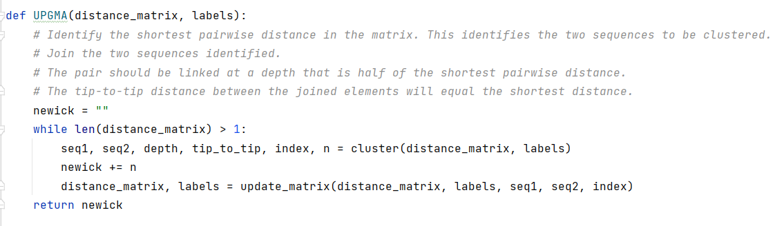
Some Important Functions

Slide 44
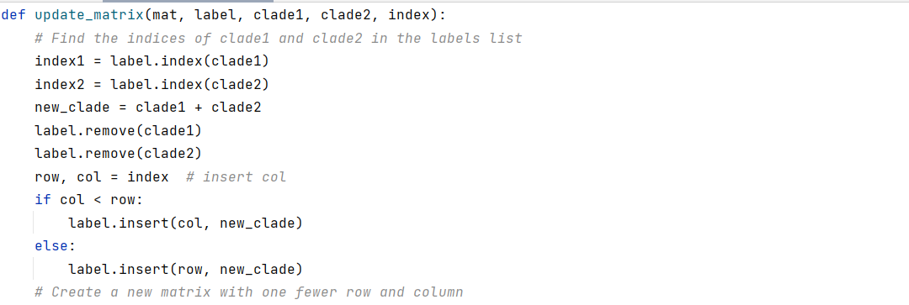
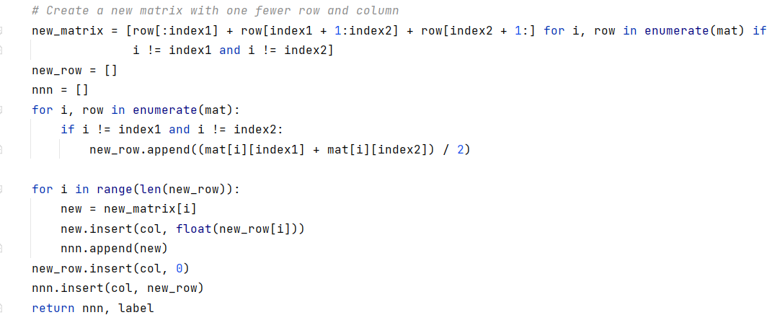

Slide 45
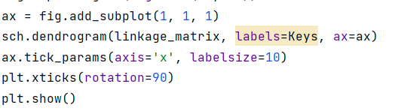
PROBLEM
I Could not generate newick string.
I tried to use a python package called ete3.

Slide 46
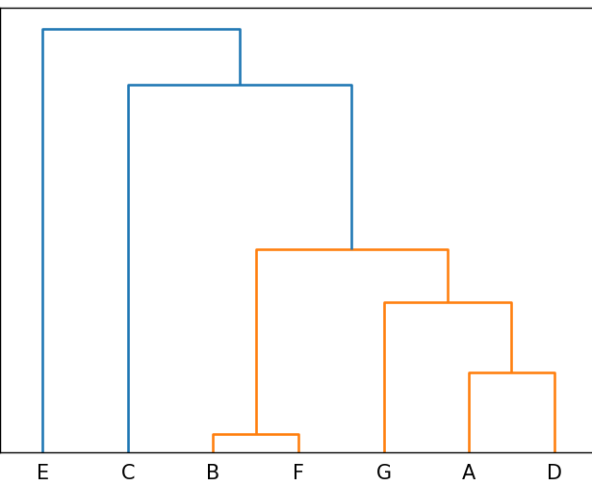
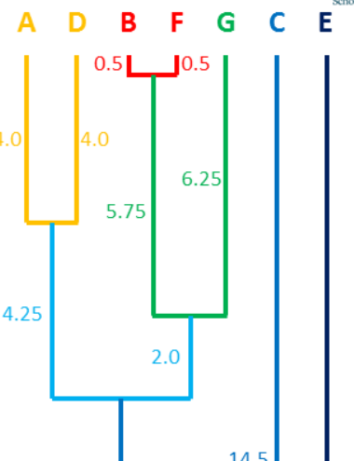
Even the python package differ from the UPGMA source

Slide 47
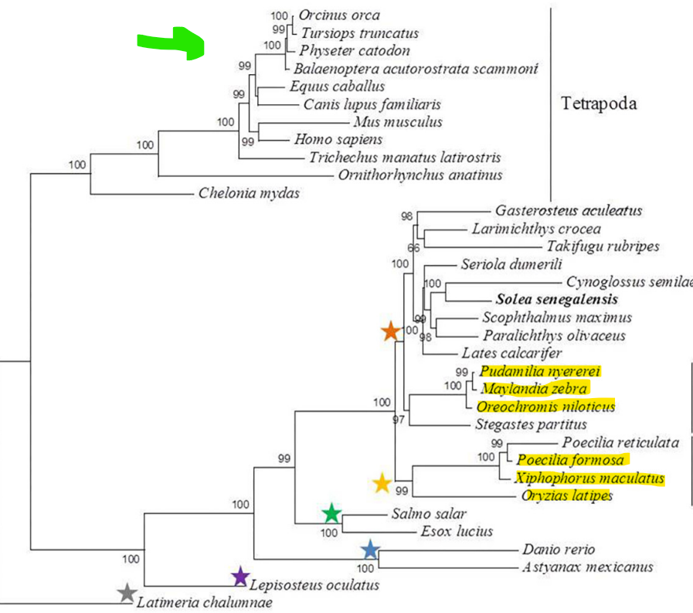
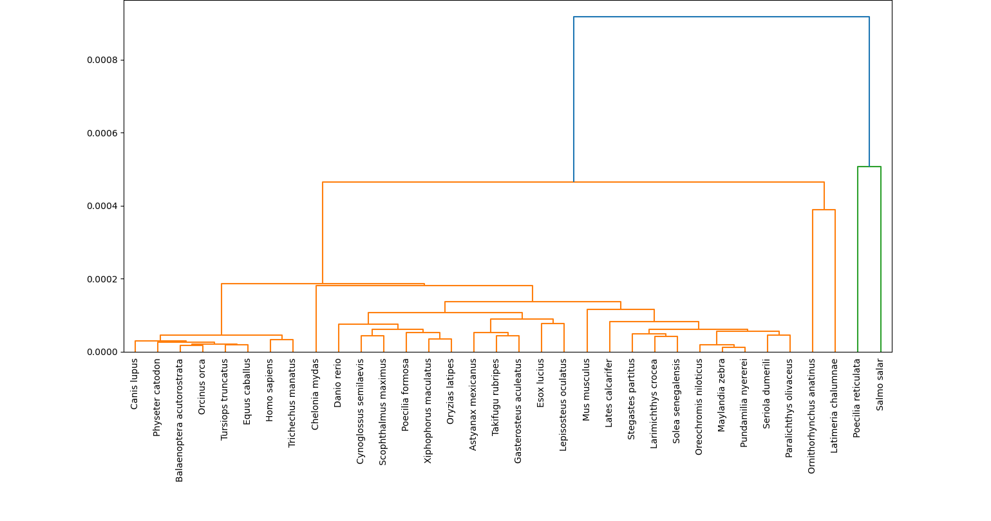

Slide 48
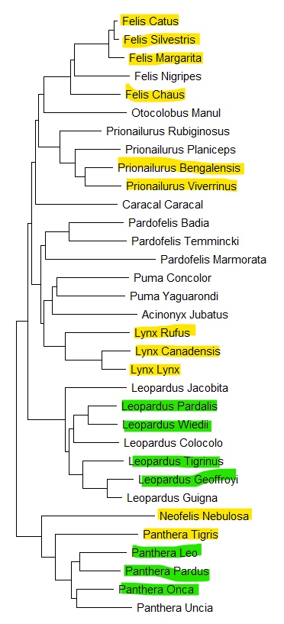
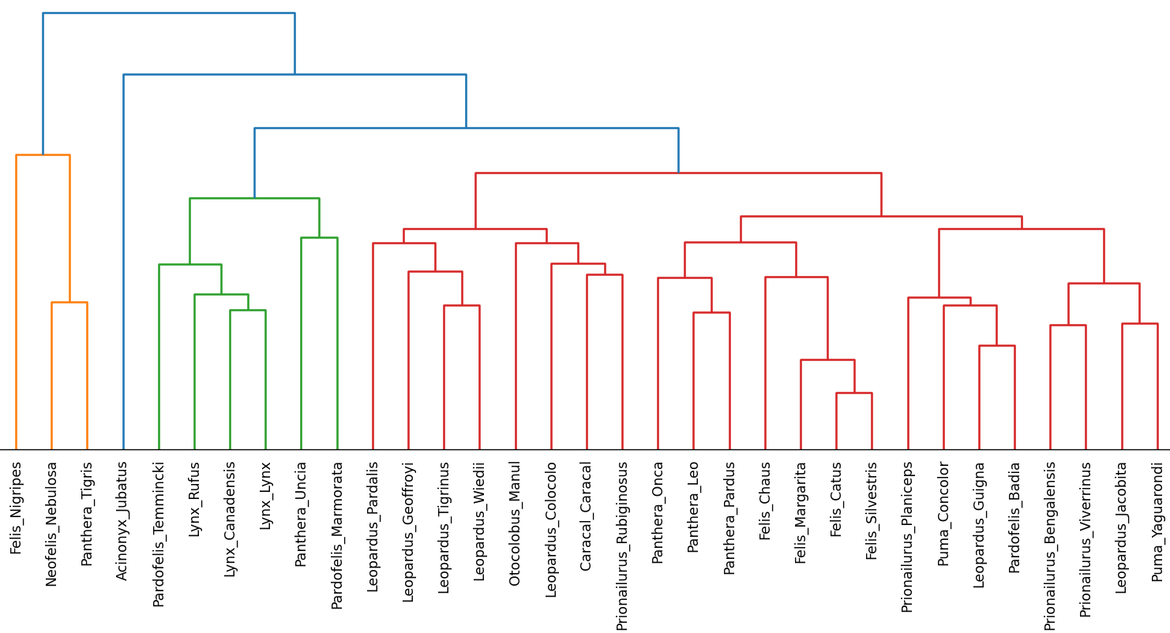

Slide 49
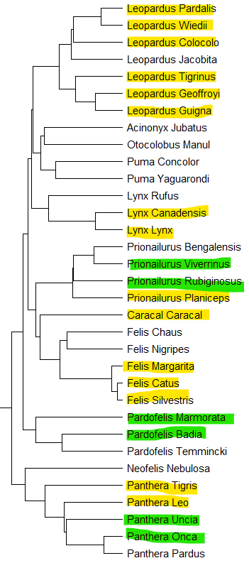
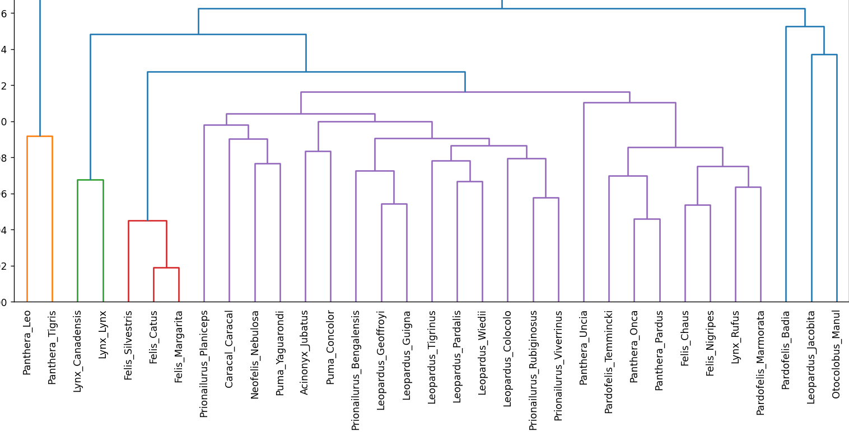

Slide 50
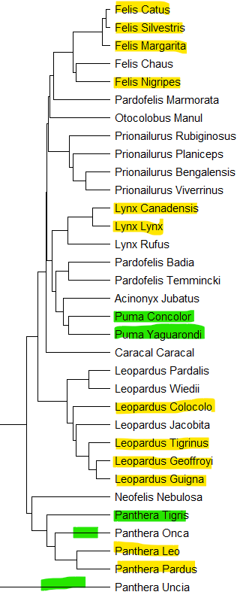
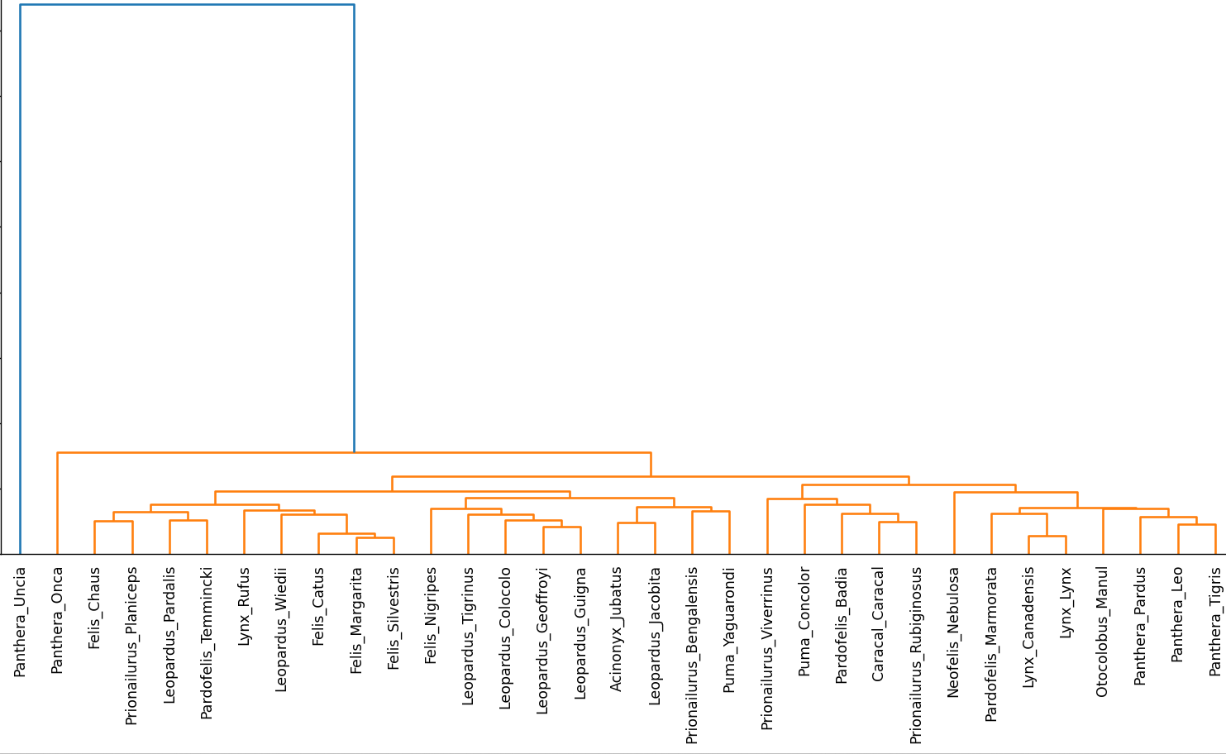

Slide 51
CONCLUSION
In the alignment free approach, the accuracy was approximately 30%. This accuracy may be because the built in function dendrograms, or k-mer approach has low accuracy than the alignment based tools.
For maximum likelihood, the tree generated at the end was 70% accurate in comparison to the PHYML Acgt-montlier, as the multiple sequence alignment could have been affected by the amount of strains compared.

Slide 52
References
A. Kundu, R. T. Usha, N. K. Samia, and M. M. Rahman, “Alignment-free phylogenetic tree estimation,” in 2019 Innovations in Power and Advanced Computing Technologies (i-PACT), 2019.
L. Kannan and W. C. Wheeler, “Exactly Computing the Parsimony Scores on Phylogenetic Networks Using Dynamic Programming,” Journal of Computational Biology, vol. 21, no. 4, pp. 303–319, Apr. 2014, doi: 10.1089/cmb.2013.0134.

Slide 53
THANKS!

